Slide 1
Lankabangla Security Portal v1.0
Developed by DataCoders
2021237 Md. Omar Bin Sarwar
1920585 Shazneen Islam Akhi
1611001 Iftakhirul Mohaimin Alif

Slide 2
Rich Picture AS IS

Slide 3
Rich Picture to be

Slide 4
Problem Analysis

Slide 5
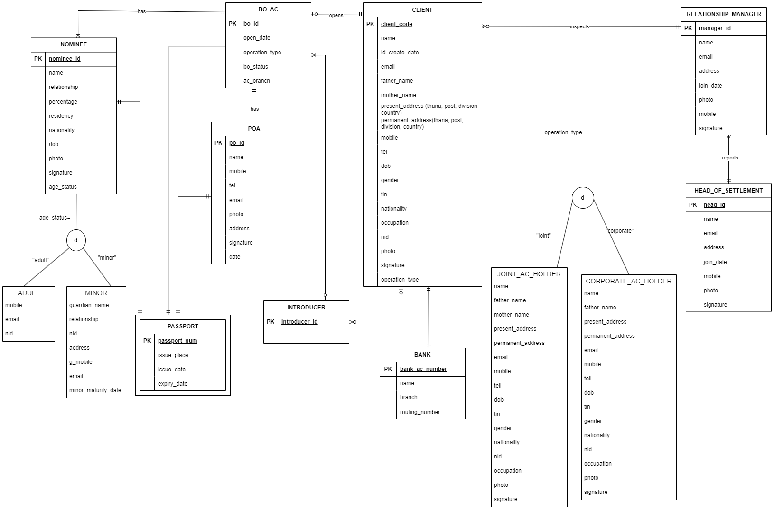
ERD

Slide 6
ERD

Slide 7
ERD

Slide 8
ERD

Slide 9
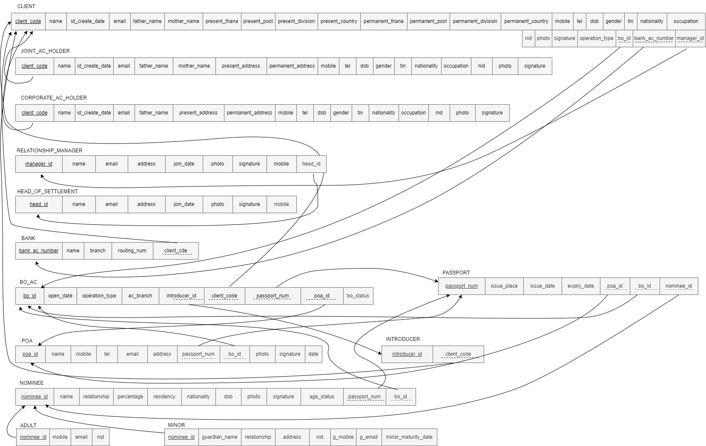
Relational Schema

Slide 10
Future Implementations

Slide 11
THANK YOU

